Slide 1
Algorithms #2
A supplemental lesson for AP CSP
This lesson is based from a project created by Amazon Future Engineers + edhesive called “Warehouse Challenge” and Code.org Unit 5 programming unit 2018.

Slide 2
Algorithms
AP CSP Big Idea #3
All programming languages use similar programming structures and commands.
Students should have a basic understanding of how these building blocks are combined to form algorithms and abstractions.
This big idea focuses on determining the efficiency of algorithms, as well as writing and implementing algorithms in a program.

Slide 3

Algorithms
From the AP CSP Curriculum and Exam Description:
Today’s lesson will give you practice in algorithms using robot code.
The code will use if and if/else statements.

Slide 4
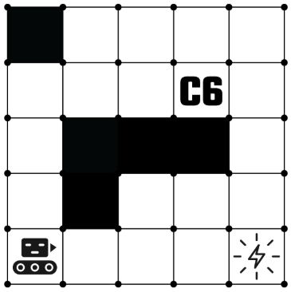
The Warehouse Map
Robots move one square at a time.
Robots move freely on white squares.
Black squares are shelves or walls, and robots cannot move there.
If a robot tries to move into a black square or the edge of the warehouse, it will crash and the program stops.
Letters and numbers on the map indicate packages to be picked up or chutes where packages are delivered.

Slide 5
Robot Code:
Robots can only follow very precise instructions.
They move or perform actions in the warehouse based on program code.
Robots follow each of the commands in the code one line at a time, in order.

Slide 6
Robot Commands:
MOVE_FORWARD()
Robot moves one square forward in the direction it is facing.
ROTATE_LEFT()
Robot rotates 90 degrees counterclockwise (robot’s left) in the square it is in.
ROTATE_RIGHT()
Robot rotates 90 degrees clockwise (robot’s right) in the square it is in.
If any of the commands have a number in parenthesis (an argument), the action is performed that many times. Otherwise, the action is performed once.

Slide 7
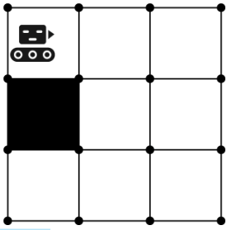
Robot Commands:
CAN_MOVE(direction)
Using robot sensors, the robot checks to see if there is an open square in the direction specified.
The statement evaluates to True or False.
The robot does not move, but answers the question: Can I move [left, right, or forward]?
CAN_MOVE(forward) → True
CAN_MOVE(left) → False
CAN_MOVE(right) → False

Slide 8
Robot Control Structures:
IF (condition)
{ robot commands
}
The robot commands will execute only when the condition is True. When the condition is False, the robot commands are skipped.
IF (condition)
{ robot commands
}
ELSE
{ robot commands
}
The first commands will execute only when the condition is True. When the condition is False, the second set of commands is executed.

Slide 9
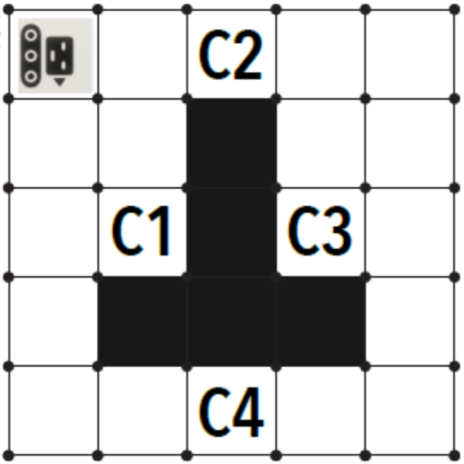
Robot Code:
Solve the problem on your activity guide:

Slide 10
More Robot Code
Try more robot code problems
These problems will give some code with if or if/else statements.
For each code, there are three scenes.
Try the same code for each scene.
For each scene, does the robot get the diamond, miss the diamond, or crash?
Some of the code is written as block, and some code is written in text.

Slide 11
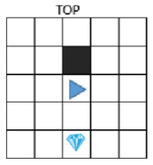
Robot Code:
Try this sample problem:
Scene #1
PROGRAM:
rotate_left()
if can_move(forward):
move_forward()
else:
rotate_left()
rotate_left()
move_forward()
Notes:
Answer: Miss the diamon

Slide 12
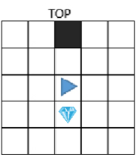
Robot Code:
Try this sample problem:
Scene #2
PROGRAM:
rotate_left()
if can_move(forward):
move_forward()
else:
rotate_left()
rotate_left()
move_forward()
Notes:
Answer: Crash!

Slide 13
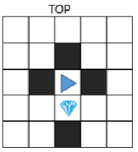
Robot Code:
Try this sample problem:
Scene #3
PROGRAM:
rotate_left()
if can_move(forward):
move_forward()
else:
rotate_left()
rotate_left()
move_forward()
Notes:
Answer: Get the diamond!

Slide 14

Your turn!
Can you determine when the robot gets the diamond, misses the diamond, or crashes?
Complete the problems on your activity guide.

